Slide 1
Context Diagram &
DATA FLOW DIAGRAM

Slide 2

Context Diagram
Top-level view of Information System
It shows the system as a single high-level process and shows the relationship with other external entities.
Example: Order system that a company uses to enter orders and apply payments against a customer’s balance

Slide 3
Context Diagram
Features:
Only one process (numbered 0)
External entities as squares
Line shows data flows
No data stores are shown

Slide 4
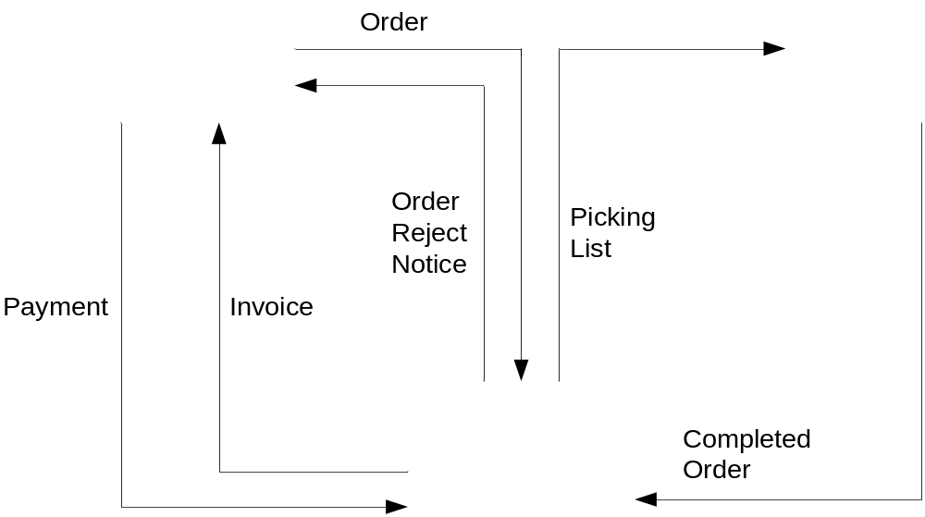
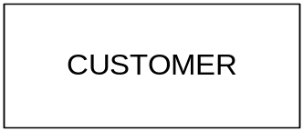

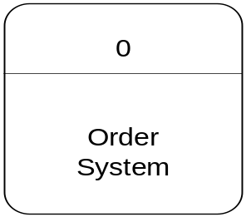
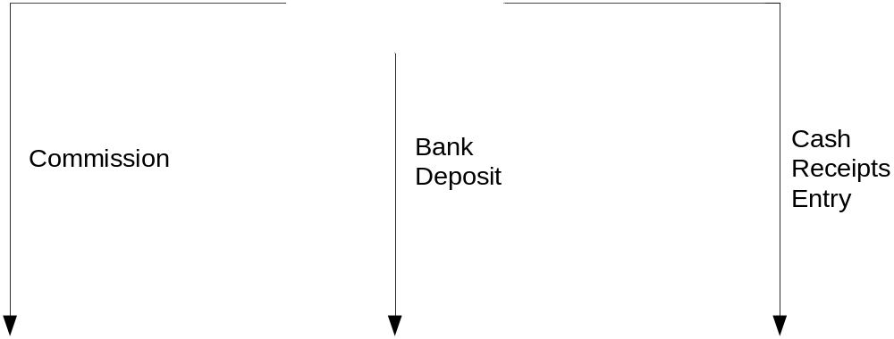


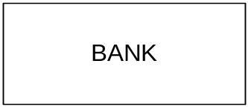
Context Diagram of Order System

Slide 5

DFD
Process
  An activity or function performed for a specific business reason
  Manual or computerized
Data flow
  A single piece of data or a logical collection of data
  Always starts or ends at a process
6 - <number>

Slide 6
DFD Elements
Data Store
  A collection of data that is stored in some way
  Data flowing out is retrieved from the data store
  Data flowing in updates or is added to the data store
External entity
  A person, organization, or system that is external to the system but interacts with it.
6 - <number>

Slide 7
Rules of DFD:
1. Flows from: Left to right; Top to bottom
2. External Entity(EE) – Process, Process – Process, Process – Data File : OK
3. EE – EE, EE – Data File, DB – DB : NO
4. Used Four Symbols only
5. Each process has name and numbered
6. EE, Data Files are written in Capital Letter
7. Process has first letter Capital letter
6 - <number>

Slide 8
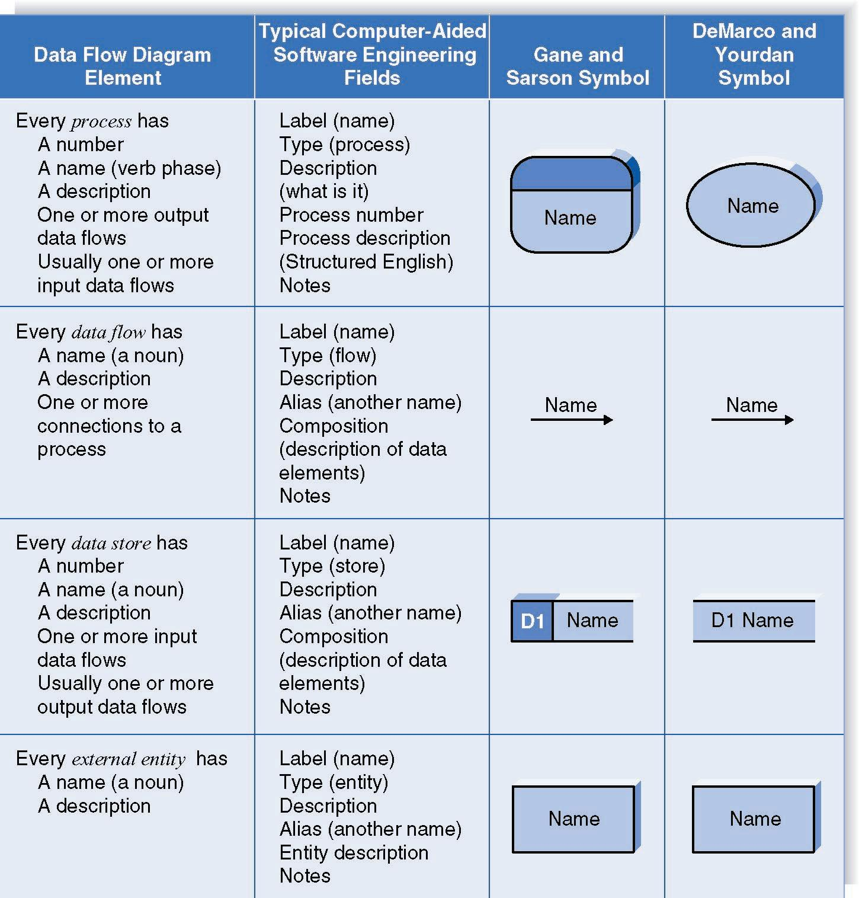
Naming and Drawing DFD Elements
Process
Data flow
Data store
External
entity
6 - <number>

Slide 9
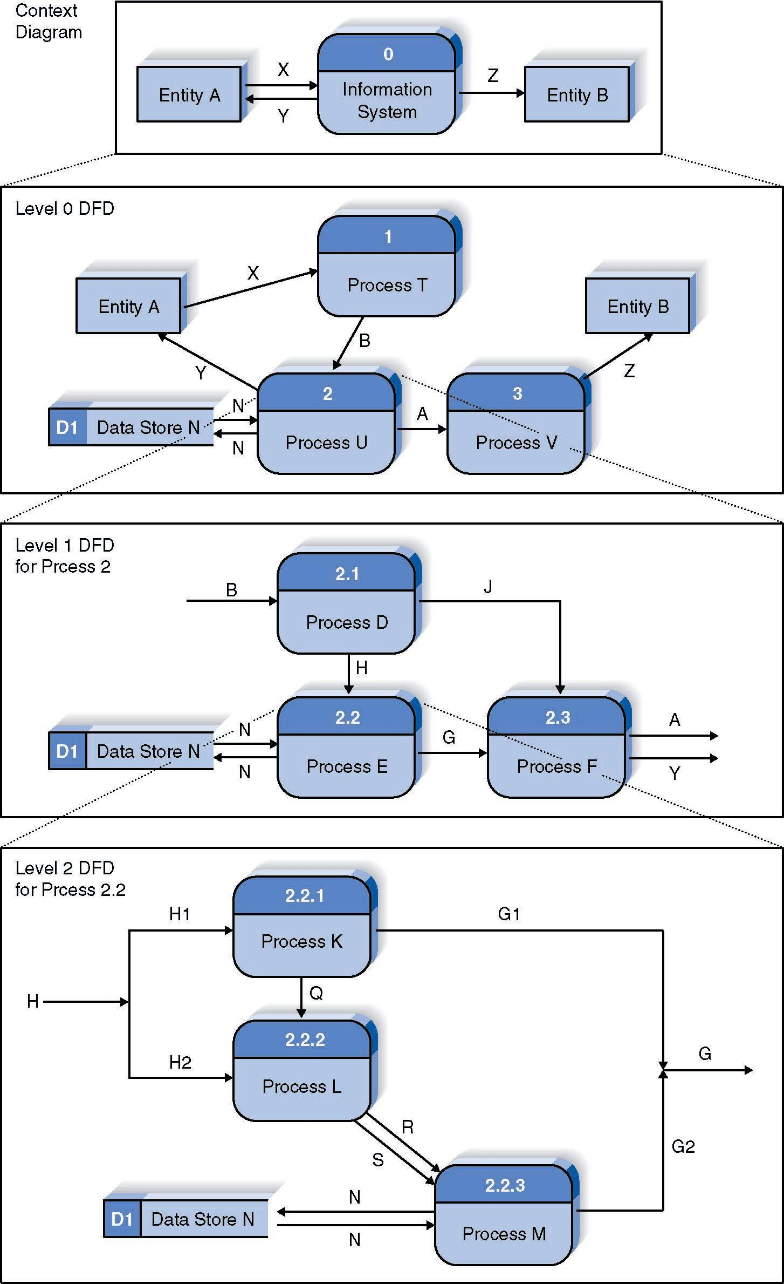
Relationship Among DFD levels
Context diagram
Level 0 diagram
Level 1 diagram
Level 2 diagram
6 - <number>

Slide 10
Level 0 Diagram
Shows all the major processes that comprise the overall system – the internal components of process 0
Shows how the major processes are interrelated by data flows
Shows external entities and the major processes with which they interact
Adds data stores
6 - <number>

Slide 11
Level 1 Diagrams
Generally, one level 1 diagram is created for every major process on the level 0 diagram
Shows all the internal processes that comprise a single process on the level 0 diagram
Shows how information moves from and to each of these processes
If a parent process is decomposed into, for example, three child processes, these three child processes wholly and completely make up the parent process
6 - <number>

Slide 12
Level 2 Diagrams
Shows all processes that comprise a single process on the level 1 diagram
Shows how information moves from and to each of these processes
Level 2 diagrams may not be needed for all level 1 processes
Correctly numbering each process helps the user understand where the process fits into the overall system
6 - <number>

Slide 13
Summary
The Data Flow Diagram (DFD) is an essential tool for creating formal descriptions of business processes.
Use cases record the input, transformation, and output of business processes and are the basis for process models.
Eliciting use cases and modeling business processes are critically important skills for the systems analyst to master.
6 - <number>

Slide 14
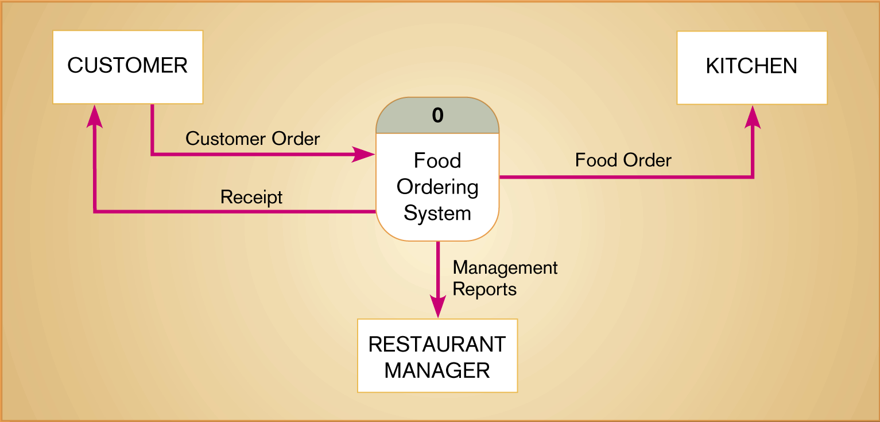
Example : Hoosier Burger’s Food ordering system

Slide 15
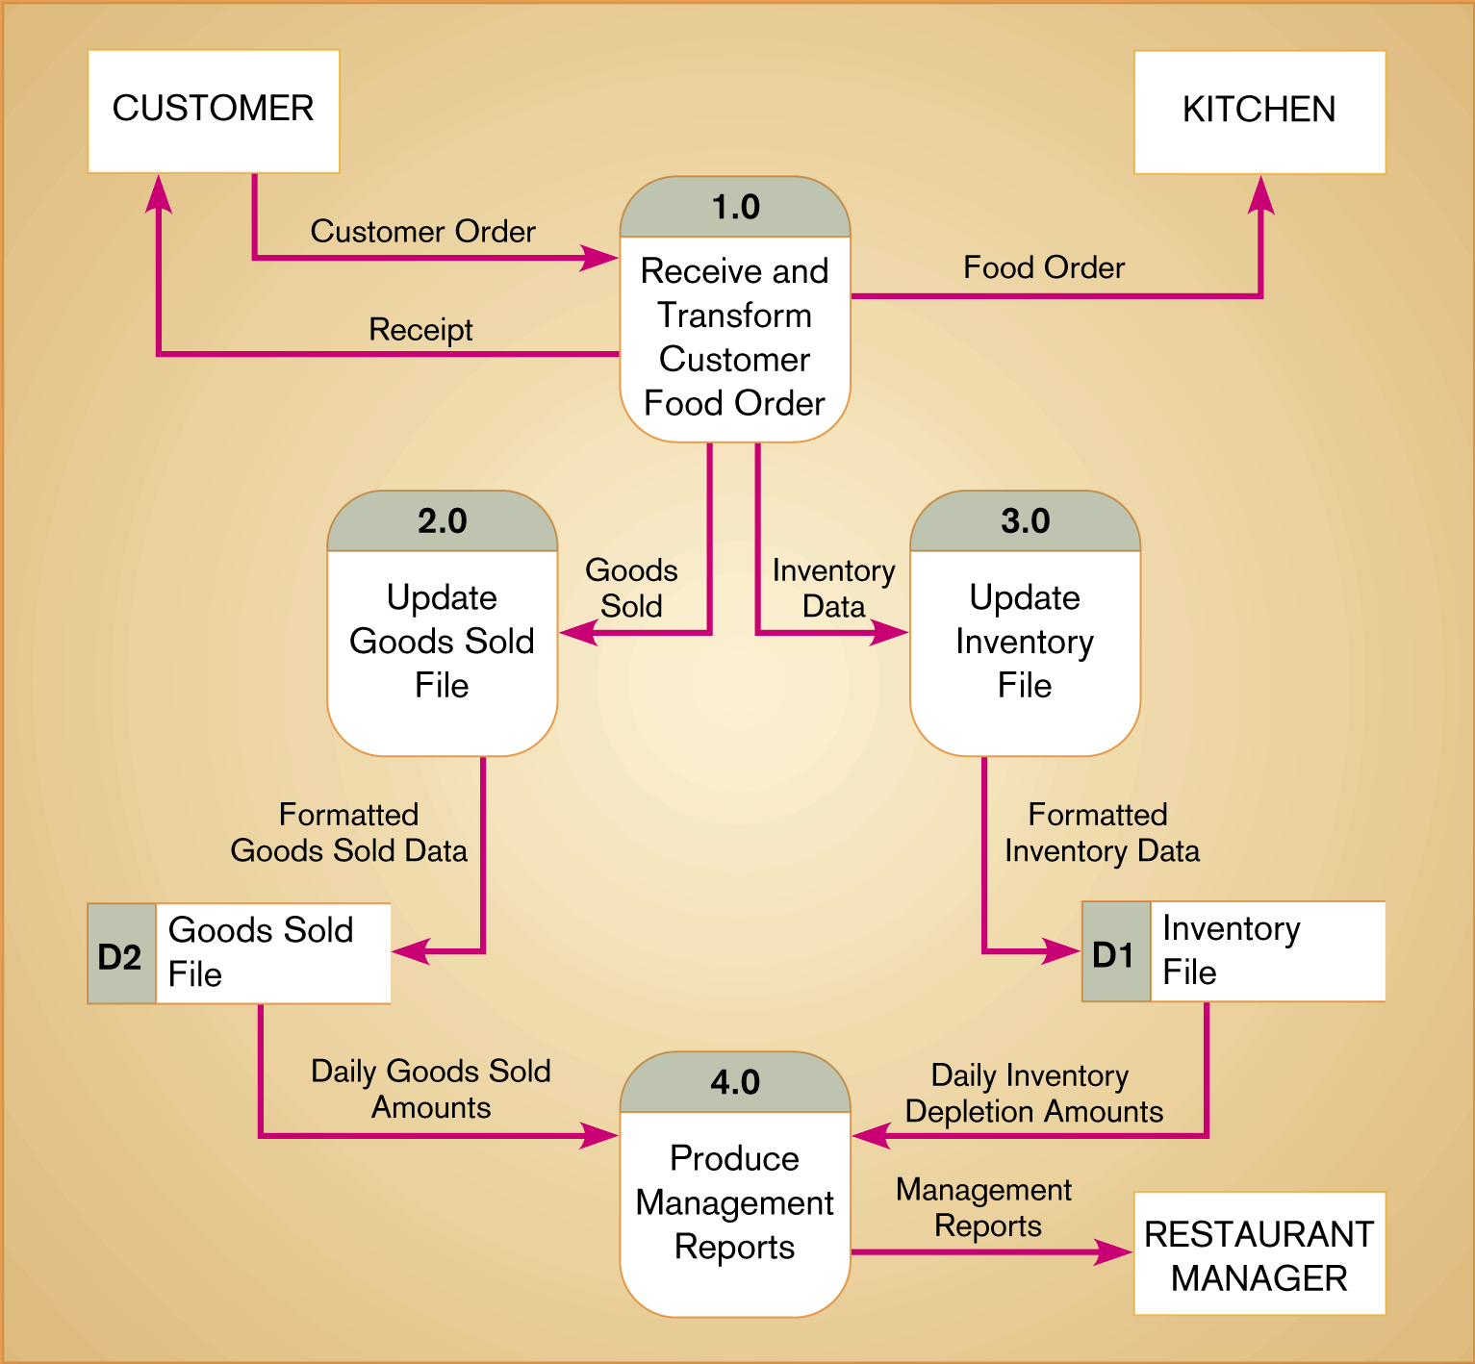
Figure 2 : Cont…
Level-0 DFD of Hoosier Burger’s food ordering system

Slide 16
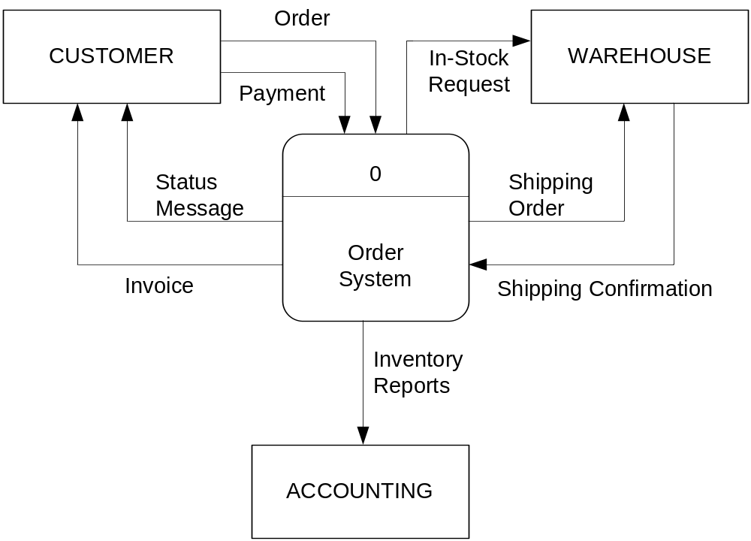
Context Diagram of Order System

Slide 17
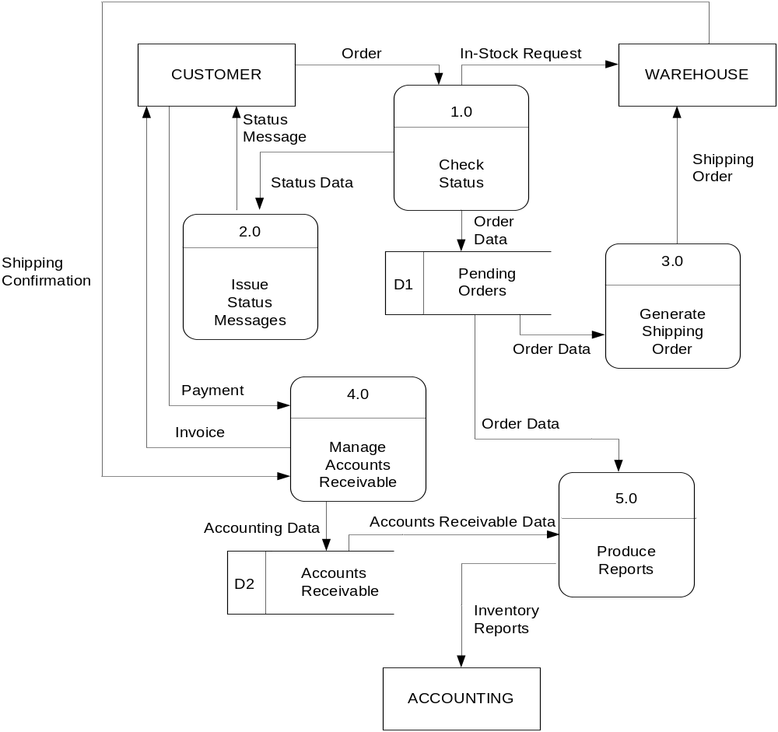
Level-0 of Order System

Slide 18
HOMEWORK (group)
Based on the use cases, draw your project data flow in:
  Context diagram
  Level 0-DFD
  If neccesary, decompose the DFD to the next level DFDs
  Put them on your SRS’s document as the attachment

